Slide 1


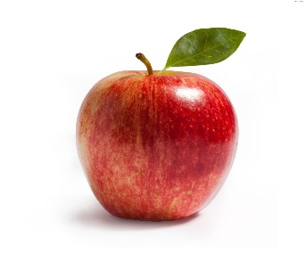

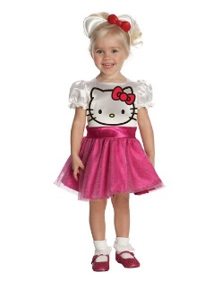
Matching Native Language to Second Language Learning: Languages are not Equally Difficult
Rebecca E. Knoph, Elizabeth G. Kusel, Erin M. Buchanan
Introduction
Chomsky (1984) theorized that language is an innate ability ingrained in all humans as expressed by universal grammar. Later, Mitchell and Myles (1998) explained that when faced with learning a second language, we learn the features of this new language in the same order as our first and subsequent languages. When trying to learn a second language, we theorize that that learning will come with more ease when the languages are similar – which would match a positive transfer of expertise in the first language mapping onto the second.
For this experiment, we asked English natives to learn simple phrases and words in Swedish and Italian. Swedish and English are both Indo-European languages (Germanic) while Italian is a Romance language similar to French and Spanish (Italic). Therefore, Swedish learning questions should be easier while Italian learning questions may be more difficult and discriminable due to negative transfer from English.
This positive and negative transfer may only be present for this initial learning process, and may fade over time.
Participants
93 participants were included in this study. All participants were recruited through introductory Psychology courses for course credit.
37% of the sample identified themselves as male; 62% as female.
Ages ranged from 18-50 years old with the average age of the sample being 19.41 years old, SD = 4.00 years.
Procedure
All participants were directed to Qualtrics and asked some brief demographic questions, such as expertise with the target languages.
Participants then received a 20-minute lesson either on basic Swedish or basic Italian (randomly assigned).
Although the language order was randomly assigned, the order of the questions remained constant and were matched verbatim for both languages.
Questions began as multiple choice for learning purposes, but increased in difficulty to include multiple choice for testing purposes, matching, and sentence translation.
Once participants concluded the lesson, they received the lesson for the second language.
Multiple Choice- Learning and Screening Purposes
The first four questions provided a basis for learning the language. Pictures in each answer option gave participants time to connect the target word to the picture and possibly to the English equivalent word.
For example, see Figure 1.
Since these questions had pictures, it was assumed that participants should get these correct. Instead, these were used to screen out participants that could not understand the directions or were not making a true effort in this study; defined as anyone correctly answering three or less of the four questions correctly.
Abstract
Participants were given a short lesson on Italian and Swedish, similar to DuoLingo. Although both were relatively easy, differences in the variance, discriminability, and difficulty were found between the two languages.
Multiple Choice- Test Questions
Once participants had learned a few basic words, they were presented with multiple choice questions that lacked the pictures. Participants had to begin to rely on their recognition memory to correctly answer questions.
For example, “How do you say ‘apple’ in Swedish?”
Matching Questions
As participants began to learn abstract words (such as “a”), they were presented with drag-and-drop matching questions. Participants had to use their recognition memory and correctly identify multiple matching words simultaneously.
For example, see Figure 2.
Sentence Translations
Finally, participants were asked to translate short phrases and sentences. Most sentences included a word or two that had not been presented to the participant, but should be translatable within the context of the other words. This concluding section required participants to rely on their memory and contextual skills to correctly translate the phrase.
For example, “Translate this sentence: ‘Jag är en pojke.’”
Results
Item Response Theory was used to determine differences in difficulty and discrimination between the Italian and Swedish lesson. Both a 2PL and a 3PL model were programmed, but a 2PL analysis is used since these two models were not significantly different.
Items with ceiling effects (SD < 0.15) were removed from the analysis.
When comparing the difficulty coefficients on remaining items, it appears that Swedish is easier on multiple choice, but Italian is easier for matching and translation in general (see Figure 3).
When comparing discriminability coefficients on remaining items, it appears that Swedish is more discriminable for translation while Italian is more discriminable for multiple choice and matching in general (see Figure 4).
However, this is heavily biased by the omission of items with ceiling effects and should be taken into consideration.
Discussion
Traditional IRT requires a dichotomized outcome, which loses valuable information about complex question scoring. When comparing the average score by item using the dichotomized scores (see Figure 5), differences between languages seem more distinct than when comparing average score allowing for partial credit (see Figure 6).
Further, time constraints led to the sole use of basic knowledge questions for testing. 20 minutes is not enough time to solidify any testable language skills. The lack of answering variability forced us to omit most items since most participants were scoring extremely well.
Although it seems that a trend may be present (see Figure 7), future research will require much more time with participants to gain enough skills in multiple languages to test a larger variety of questions ranging in difficulty level.
Figure 1. Example item for screening multiple choice questions.
Figure 2. Example item for matching questions.
Which of these is “a boy”?
La donna La mela
Un ragazzo Una ragazza
Drag the Italian word to the correct English word.
Italian Items
donna
English Items
Boy
ragazzo
Is
sono
I
io
Girl
ragazza
Figure 3. Difficulty coefficients for items remaining in the IRT for both languages.
Figure 4. Discriminability coefficients for items remaining in the IRT for both languages.
Figure 5. Average score by each item, dichotomizing (no partial credit).
Figure 6. Average score by each item, allowing for partial credit.
.
Figure 7. Average score of all questions by each type of question, allowing for partial credit.
Contact Us: For more information, e-mail us at Rebecca.Knoph@gmail.com

